Slide 1
Prompt Engineering
& Vibe Coding
How to talk to AI — and how to build with it
Session 2 — GenAI Cohort
Saksham Arora
Software Engineer II @ Intuit
Ex - Software Engineer @ Microsoft
https://www.linkedin.com/in/sakshamarora9575/

Slide 2
Quick Recap — What We Learned Last Time
An LLM (like Chat GPT) is just a very smart auto-complete.
It guesses the next word, again and again, until your answer is done.
It has problems we need to fix:
• It can make stuff up (hallucination)
• It doesn't know your company's data
• It has a date cutoff — doesn't know about anything after that date
Today, we'll learn the FIRST and EASIEST way to get better answers:
Just talk to it better. That's prompt engineering.

Slide 3
What We'll Cover Today
① What is a prompt? Why do good prompts matter?
② The 4-part recipe for a great prompt
③ Prompt techniques — zero-shot, few-shot, role-based
④ Chain-of-Thought — making AI 'think step by step'
⑤ Vibe Coding — building software by chatting with AI
⑥ Live examples + a quick exercise

Slide 4
What Is a Prompt?
A prompt is the message you send to the AI.
That's it. Whatever you type into Chat GPT — that is a prompt.
Examples of prompts:
"Translate this sentence to Hindi"
"Write a Python function to add two numbers"
"Explain machine learning to a 10-year-old"
Prompt engineering = writing your message in a smart way
so the AI gives you a better answer.
It is the cheapest, fastest, and most powerful skill in GenAI.
No coding required. No new libraries. Just better English.

Slide 5
The 4-Part Recipe — R.T.C.F.
R — Role
Tell the AI WHO it should pretend to be.
"You are an expert Python tutor."
T — Task
Tell the AI exactly WHAT to do.
"Explain how a for-loop works."
C — Context
Give the AI any background info it needs.
"My student knows variables and if/else, but nothing else."
F — Format
Tell the AI HOW you want the answer.
"Answer in 3 short bullet points with one example."
Use all 4 every time you really care about the answer.

Slide 6
Example 1 — Asking AI to Write an Email
✗ Bad Prompt
✓ Good Prompt (R.T.C.F.)
"Write an email to my manager"
What the AI does:
• Guesses the topic
• Guesses the tone
• Guesses the length
• Adds random details
You'll have to edit it 5 times.
Role: You are a professional employee.
Task: Write an email to my manager
asking for 2 days of leave next week.
Context: I want leave on Thursday and
Friday. Reason: my sister's wedding.
Format: Keep it 3 short paragraphs,
polite tone, with a clear subject line.

Slide 7
Example 2 — Asking AI for Code
✗ Bad Prompt
✓ Good Prompt (R.T.C.F.)
"Give me code for login"
What the AI does:
• Picks a random language
• Picks a random framework
• Skips validation
• No error handling
You'll spend 30 minutes
fixing it.
Role: You are a senior Python
developer.
Task: Write a login function.
Context: We use Flask. Username +
password come from a form. Check
against MySQL 'users' table.
Format: One function, with comments
and basic error handling.

Slide 8
3 Prompt Techniques You Should Know
There are dozens of fancy techniques. We'll learn the 3 that matter most:
① Zero-shot prompting
Just ask, no examples given. Simplest form.
② Few-shot prompting
Show the AI 2-3 examples first, then ask your question.
③ Role-based prompting
Tell the AI to act as a specific expert.
Master these three and you'll handle 90% of real situations.

Slide 9
Technique 1 — Zero-Shot Prompting
"Zero" examples. You just ask. The AI figures it out.
Example:
"Classify this review as Positive or Negative:
"The food was cold and the waiter was rude." "
AI answers:
Negative
When to use:
• Simple tasks: translate, summarize, classify common things
• When the task is obvious from the words alone
When NOT to use:
• Tasks with custom rules or formats your AI can't guess
• When you need a very specific style of answer

Slide 10
Technique 2 — Few-Shot Prompting
Give the AI a few examples first. Then ask your real question.
Like teaching a kid: "see how I did these 2? now you try."
Example — extract the city from a sentence:
Sentence: "I am flying to Mumbai tomorrow." → City: Mumbai
Sentence: "Bangalore weather is great." → City: Bangalore
Sentence: "Met my friend at Delhi airport." → City: Delhi
Sentence: "Heading to Hyderabad next week." → City: ?
AI sees the pattern and answers: Hyderabad
When to use:
• You need a very specific format in the answer
• The task is unusual or company-specific
• Zero-shot gave you garbage

Slide 11
Example 1:
Q: Shopkeeper buys apples at Rs 10 each, sells at Rs 15.
Sells 20 apples. Profit?
Reasoning: CP = 20 x 10 = 200.
SP = 20 x 15 = 300.
Profit = 300 - 200 = 100.
A: The profit is Rs 100.
Now solve this:
Q: A vendor buys pens at Rs 5, sells at Rs 8. Sells 50 pens.
Daily profit?
Reasoning: [think step by step]

Slide 12
Technique 3 — Role-Based Prompting
Tell the AI: "You are a ___". The answer style changes a LOT.
Same question: "Why is my code slow?"
Role 1: "You are a beginner Python tutor."
→ Friendly, simple language, beginner-level tips
Role 2: "You are a senior performance engineer at Google."
→ Technical, talks about profiling, big-O, caching
Role 3: "You are a sarcastic StackOverflow user."
→ Snarky reply telling you to "just read the docs"
Why it works:
The role primes the AI to pick the right vocabulary, depth, and tone.
Pro tip — combine it: 'You are a senior X. Explain Y to a junior Z.'

Slide 13
Chain-of-Thought — Make AI Think Step by Step
Sometimes the AI rushes the answer and gets it wrong.
The fix is one magic phrase:
"Let's think step by step."
That's it. You add this one line and the AI:
• Slows down
• Breaks the problem into small parts
• Checks each part before moving on
This works almost like magic for:
• Math problems
• Logic puzzles
• Multi-step instructions
• Debugging code

Slide 14
Chain-of-Thought — Real Example
✗ Without CoT
✓ With CoT
Prompt:
"A shop has 23 apples. It sells
5 in the morning, then buys 12
more, then sells 7 in the evening.
How many apples are left?"
AI (rushing):
"The shop has 18 apples."
Wrong! It guessed.
Prompt: same question +
"Let's think step by step."
AI:
Start: 23 apples
Sold 5 → 23 - 5 = 18
Bought 12 → 18 + 12 = 30
Sold 7 → 30 - 7 = 23
Answer: 23 apples. ✓

Slide 15
Chain-of-Thought — Quick Guide
Use Chain-of-Thought when:
• The question needs counting, math, or logic
• There are 2 or more steps to reason through
• The first answer felt 'rushed' or wrong
Easy phrases that trigger CoT:
"Let's think step by step."
"Walk me through your reasoning."
"Show your working."
"Solve this carefully, one step at a time."
Bonus:
• Modern models (GPT-4, Claude, Gemini) often do CoT automatically
• But adding the phrase always helps when in doubt

Slide 16
What Is 'Vibe Coding'?
Term coined by Andrej Karpathy (2025) — co-founder of OpenAI.
Old way of coding:
You type every line. You read docs. You debug for hours.
Vibe coding:
You describe what you want — in plain English.
The AI writes the code.
You run it. If it works, great. If not, you tell the AI what's wrong.
Repeat until done.
"You give in to the vibes. You forget that the code even exists."
— Andrej Karpathy
It works because today's AIs are very good at writing working code.

Slide 17
The Vibe Coding Loop — 4 Simple Steps
① Describe
Tell the AI what you want. e.g. "Build me a to-do list app in React."
② Generate
The AI writes the code. You don't write it line-by-line.
③ Run
You hit Run / Preview. See if it works.
④ Refine
Tell the AI what to change. e.g. "Make the buttons blue. Add a delete button."
Then go back to step 2. Repeat until happy.
You don't need to read every line — you just need to know what you want.

Slide 18
Popular Vibe Coding Tools
Tool | Best for | Free tier?
Cursor | Coding inside an IDE (like VS Code) | Yes (limited)
GitHub Copilot | Auto-complete inside VS Code | Free for students
Lovable | Build full web apps from one prompt | Yes
v0 by Vercel | Generate UI / React components | Yes
Bolt.new | Build & deploy apps in browser | Yes
Replit Agent | Full apps, chat-based | Yes (limited)
Claude Code / Codex | Terminal-based AI coding | Paid
Pick one and play with it. They all work the same way underneath.

Slide 19
Vibe Coding — Do's and Don'ts
✓ DO
✗ DON'T
• Be very specific in your first
prompt — describe everything
• Show examples of what you want
• Run the code often — every few
minutes, not at the end
• Ask AI to explain code you don't
understand
• Save your work to git — you'll
want to undo bad ideas
• Don't blindly copy-paste into
production
• Don't skip testing — AI code
looks right but can be subtly wrong
• Don't paste passwords or secrets
into prompts
• Don't ignore errors — paste them
back to the AI
• Don't trust AI on security or
money-related code without review

Slide 20
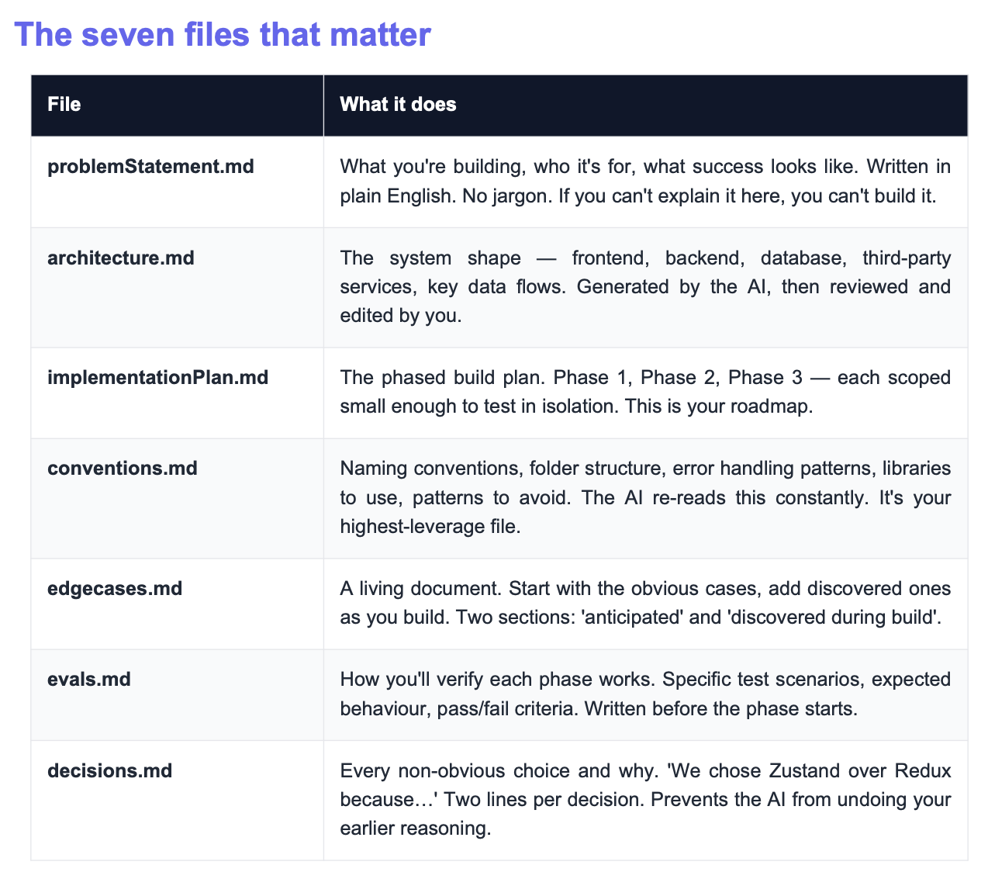

Slide 21
Key Takeaways
① A prompt is just your message to the AI. The clearer, the better.
② Use the **R.T.C.F. recipe** — Role, Task, Context, Format.
③ Three techniques cover most cases: zero-shot, few-shot, role-based.
④ AI sees text as **tokens**. Tokens cost money and have limits.
⑤ For tricky problems, add **"Let's think step by step"** — Chain-of-Thought.
⑥ **Vibe coding** = describe → generate → run → refine. Repeat.
⑦ AI tools are powerful, but you are still the driver.
Read what they write. Test it. Don't paste secrets.

Slide 22
Homework Before Next Session
1. Pick one real task from your daily work.
(Writing a Jira ticket, drafting an email, debugging a function — anything.)
2. Solve it twice using ChatGPT (or any AI):
• First with a one-line lazy prompt
• Then with a full R.T.C.F. prompt
3. Try Chain-of-Thought on a math/logic problem.
See the difference for yourself.
4. Try one vibe coding tool — Cursor, Antigravity or Windsurf .

Slide 23
Questions?
Today: how to TALK to AI. Next: how to BUILD with it.
Saksham Arora • Software Engineer II @ Intuit

